Slide 1
Visual Cycle
It is a process by which light (or photon) is converted into electrical signals in the rod, cone and photosensitive ganglion cells of the retina of the eye.
This cycle was elucidated by George Wald (1906–1997) for which he received the Nobel Prize in 1967.
It is called ‘Wald's Visual Cycle’ after him.
It is also known as visual phototransduction.

Slide 2
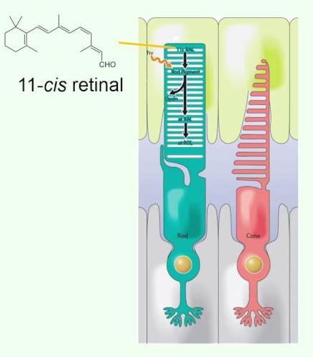
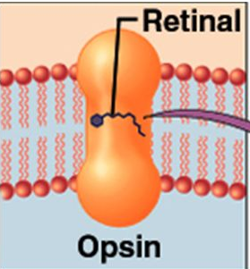
Photopigments
All photopigments associated with vision contain two parts:
1. A glycoprotein known as opsin and
2. derivative of vitamin A called retinal.
Vitamin A derivatives are formed from carotene, the plant pigment that gives carrots their orange colour.
Good vision depends on adequate dietary intake of carotene-rich vegetables such as carrots, spinach, broccoli, or foods that contain vitamin A, e.g. liver.
Retinal is the light absorbing part of all photopigments. There are 4 types of opsins in human retina, 3 in the cones and 1 in the rods (Rhodopsin), depending on small variations in the amino acid sequences.

Slide 3
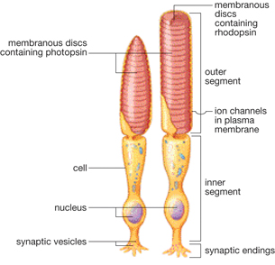
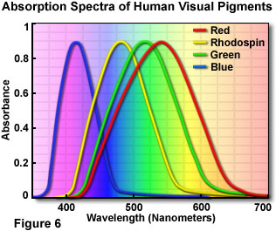
Photopigments

Slide 4
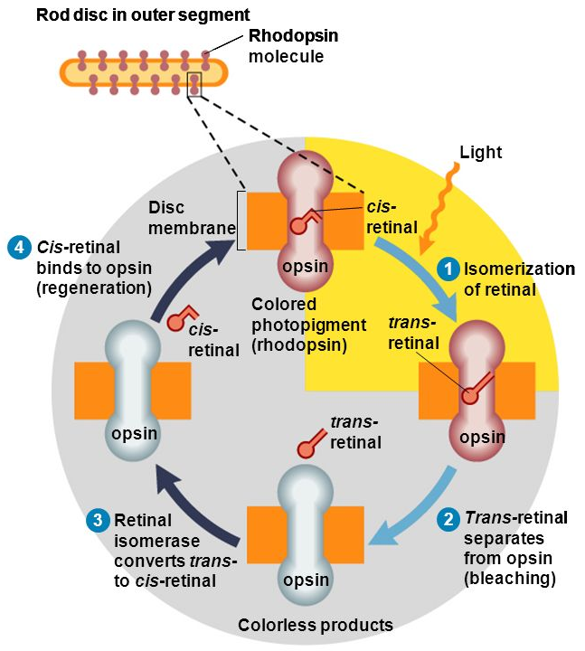
Visual cycle – the process …
In darkness, retinal has a bent shape, called cis-retinal, which fits snugly into the opsin. When cis-retinal absorbs a photon of light, it straightens out to a shape called trans-retinal. This cis-to-trans conversion is called isomerization and is the first step in visual cycle. Several unstable chemical intermediates (e.g. ions) form and disappear in this stage, leading to production of a receptor potential.
In about a minute, trans-retinal completely separates from opsin. This part of the cycle is called bleaching of photopigment.
An enzyme called retinal isomerase converts trans-retinal back to cis-retinal.
The cis-retinal then can again bind to opsin, reforming a functional photopigment. This part of the cycle is called regeneration.

Slide 5
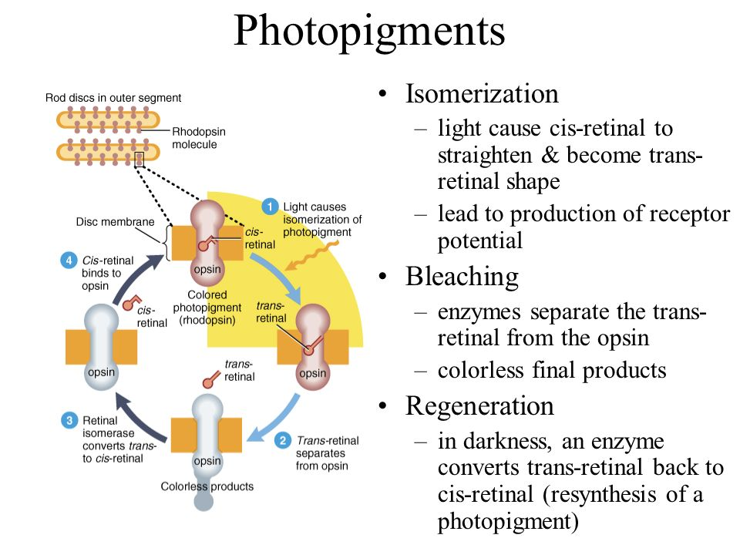

Slide 6
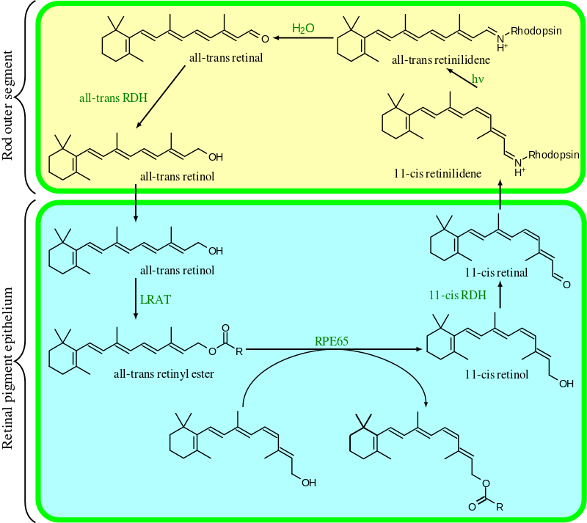
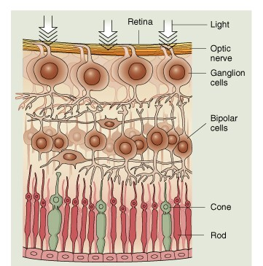
Visual cycle – the process …

Slide 7
Some important notes …
The pigmented layer of the retina adjacent to the photoreceptors stores a large quantity of vitamin A and contributes to the regeneration process in rods.
The extent of rhodopsin generation decreases drastically if the retina detaches from the pigmented layer.
Cone photopigments regenerate much more quickly than rhodopsin in rods and are less dependent on the pigmented layer.
Half of all rod pigments take 5 minutes to regenerate.
Half of all cone pigments take 90 seconds only.

Slide 8
Light and dark adaptation
Light adaptation: Dark Light
Fast. Happens in seconds
As light level increases, more and more photopigments are bleached. While light is bleaching some pigment molecules, others are being regenerated. In daylight regeneration of rhodopsin cannot keep up with the bleaching process. Hence rods contribute little to daylight vision. In contrast, cone photopigments regenerate rapidly enough even in bright light.
If light level decreases abruptly, sensitivity increases rapidly at first and then more slowly. In complete darkness, full regeneration of cone pigments occurs during the first 8 minutes of dark adaptation. During this time, a threshold light flash is seen as having colour. Rhodopsin regenerates more slowly, and our visual sensitivity increases until even a single photon can be detected. At very low light levels, objects appear as shades of grey since only the rods are functioning.
Dark adaptation: Light Dark
Slow. Takes many minutes

